Slide 1

Web Service and Database part 3 Submission form
Emerging Technology : Flutter
Week 10
Program Studi Teknik Informatika
Fakultas Teknik – Universitas Surabaya

Slide 2

BUILD FORM WITH VALIDATION
01

Slide 3

FORM WITH VALIDATION
Sometimes we need to validate user input. The validation can be invoked in frontend (client side--device), backend (server side--web service), or both.
However, client-side validation can reduce server computation and reduce bandwidth consumption. Therefore, it’s recommended to do a validation in a submission form before submitting data to server.
There are several basic validations: avoiding blank value, accepting number only, range validation, structure validation like email or website, etc.
We will start this weekly topic by implementing validation first, before studying how to insert data to database. There are 3 steps for implementing validation:
Create a form with a GlobalKey.
Add element for input with validation logic.
Add button to validate before submitting the form.

Slide 4
Preparation
We will implement validation in a form that will be used for adding new popular movie data. Prepare a stateful page, for example newpopmovie.dart. Also a menu to open this page.
The page will be added with a global key for the validation process.
GlobalKey is a special type of key that uniquely identifies an element across the entire application.

Slide 5
About FormState
FormState represents the mutable state associated with a Form widget. It provides methods to interact with and manage the form's fields, including validation, saving, and resetting.
A FormState object is automatically created and managed by Flutter when a Form widget is built
_formKey.currentState is used to get a reference to the FormState object
The validate() method on FormState triggers the validator functions of all FormField descendants within the form. It returns true if all fields are valid and false otherwise, also causing the form to rebuild and display any validation errors

Slide 6
newpopmovie.dart
class _NewPopMovieState extends State<NewPopMovie> {
final _formKey = GlobalKey<FormState>();
String _title = "";
@override
Widget build(BuildContext context) {
return Scaffold(
appBar: AppBar(
title: Text("New Popular Movie"),
),
body: Form(
key: _formKey,
child: Column(
children: <Widget>[],
),
));
}
}
class NewPopMovie extends StatefulWidget {
const NewPopMovie({super.key});
@override
State<NewPopMovie> createState() => _NewPopMovieState();
}

Slide 7
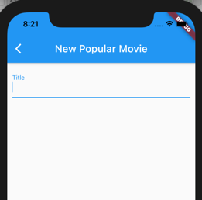
Add TextFormField
Padding(
padding: EdgeInsets.all(10),
child: TextFormField(
decoration: const InputDecoration(
labelText: 'Title',
),
onChanged: (value) {
_title = value;
},
validator: (value) {
if (value == null || value.isEmpty) {
return 'Judul harus diisi';
}
return null;
},
)
)

Slide 8
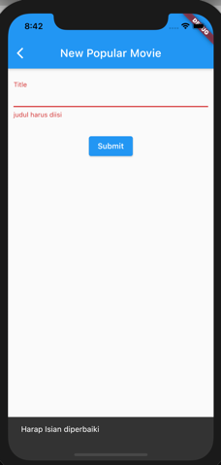
Add a Button
Padding(
padding: const EdgeInsets.symmetric(vertical: 16.0),
child: ElevatedButton(
onPressed: () {
if (_formKey.currentState != null &&
!_formKey.currentState!.validate()) {
ScaffoldMessenger.of(context).showSnackBar(
SnackBar(content: Text('Harap Isian diperbaiki')));
}
},
child: Text('Submit'),
),
),

Slide 9
WEB SERVICE
02

Slide 10
Web service preparation
Prepare a webservice using Insert query , accepting title, overview, runtime, release_date, homepage, and url . name it newmovie.php
  //setelah koneksi DB
  extract($_POST);
  $sql="INSERT INTO movie(title,overview,runtime,release_date,homepage,url)
  VALUES(?,?,?,?,?,?)";
  $stmt=$conn->prepare($sql);
  $stmt->bind_param("ssisss",$title,$overview,$runtime,$release_date,$homepage,$url);
  $stmt->execute();
  if ($stmt->affected_rows > 0) {
  $arr=["result"=>"success","id"=>$conn->insert_id];
  } else {
  $arr=["result"=>"fail","Error"=>$conn->error];
  }
  echo json_encode($arr);

Slide 11
FORM ADD MOVIE
03

Slide 12
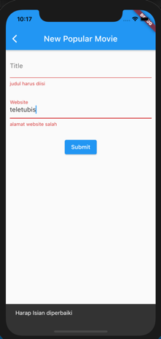
Add TextFormField for homepage
For homepage we will check the syntax of url
String _homepage = "";
Padding(
padding: EdgeInsets.all(10),
child: TextFormField(
decoration: const InputDecoration(
labelText: 'Homepage',
),
onChanged: (value) {
_homepage = value;
},
validator: (value) {
if (value == null || !Uri.parse(value).isAbsolute) {
return 'alamat homepage salah';
}
return null;
},
)),

Slide 13
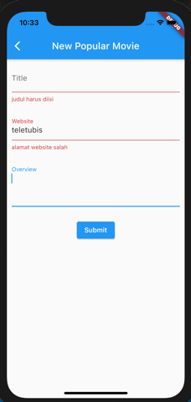
Add TextFormField for overview
Overview of the movie can be long, like a paragraph,
therefore we will create it multilined
String _overview = "";
Padding(
padding: EdgeInsets.all(10),
child: TextFormField(
decoration: const InputDecoration(
labelText: 'Overview',
),
onChanged: (value) {
_overview = value;
},
keyboardType: TextInputType.multiline,
minLines: 3,
maxLines: 6,
)),
can you add minimum character validation here?

Slide 14
Add TextFormField for release_date
For the release_date Input, we will provide a datepicker facility. The TextFormField can be automatically filled in when user clicks any date from a datepicker.
For doing this automation, we need a TextEditingController object.
final _controllerDate = TextEditingController();

Slide 15
Add TextFormField for release_date (2)
Padding(
padding: EdgeInsets.all(10),
child: Row(
mainAxisAlignment:MainAxisAlignment.start,
children: [
Expanded(
child: TextFormField(
decoration: const InputDecoration(
labelText: 'Release Date',
),
controller: _controllerDate,
)
),
ElevatedButton(
onPressed: () {
showDatePicker(
context: context,
initialDate: DateTime.now(),
firstDate: DateTime(2000),
lastDate: DateTime(2200))
.then((value) {
setState(() {
_controllerDate.text =
value.toString().substring(0, 10);
});
});
},
child: Icon(
Icons.calendar_today_sharp,
color: Colors.white,
size: 24.0,
))
],
)),

Slide 16
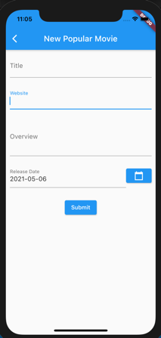
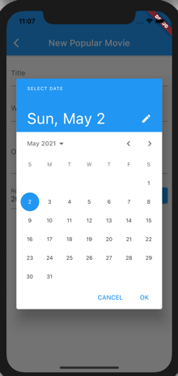
The datepicker result
Dont forget add this:
@override
void initState() {
setState(() {
_controllerDate.text = "";
});
}

Slide 17
Add runtime field
Can you add textformfield that only accept number input?
Hint:
inputFormatters: <TextInputFormatter>[
FilteringTextInputFormatter.digitsOnly
],

Slide 18
Add URL Poster
Add textformfield similar with homepage.
Add a widget below textformfield that display the poster.

Slide 19
Add URL Poster (2)
How to make the image only display a picture when the url is a valid image url?
Future<bool> validateImage(String imageUrl) async {
http.Response res;
try {
res = await http.get(Uri.parse(imageUrl));
} catch (e) {
return false;
}
if (res.statusCode != 200) return false;
Map<String, dynamic> data = res.headers;
if (data['content-type'] == 'image/jpeg' ||
data['content-type'] == 'image/png' ||
data['content-type'] == 'image/gif') {
return true;
}
return false;
}
use here:
onChanged: (value) {
validateImage(value).then((v) {
if(v)
{
setState(() {
_url = value;
});
}
});
},

Slide 20
SUBMIT DATA
03

Slide 21
Submit function
void submit() async {
final response = await http
.post(Uri.parse("https://ubaya.cloud/flutter/[NRP]/newmovie.php"), body: {
'title': _title,
'overview': _overview,
'homepage': _homepage,
'release_date': _controllerDate.text,
'runtime': _runtime,
'url':_url
});
if (response.statusCode == 200) {
Map json = jsonDecode(response.body);
if (json['result'] == 'success') {
if (!mounted) return;
ScaffoldMessenger.of(context)
.showSnackBar(SnackBar(content: Text('Sukses Menambah Data')));
}
} else {
ScaffoldMessenger.of(context)
.showSnackBar(SnackBar(content: Text('Error')));
throw Exception('Failed to read API');
}
}
Dont forget to import this:
import 'dart:convert';
import 'package:http/http.dart' as http;
Don’t forget to call this submit function in submit onPressed

Slide 22
Test
Try to add new movie. If it succeeds, check in popular movie list and try to search your new movie.
Next, when we already have EditMovie screen, after this submitting succeed, it continue to open the editing form to add the child data such as genre and casts.

Slide 23
EXERCISE
04

Slide 24
Exercise
Add a Delete button in detailpop.dart, when it is clicked, call a deletemovie.php web service.
This time, we use a simple delete :
DELETE FROM movies WHERE movie_id=?
With this simple delete query, you can only delete the new movies which are added by our previous submission form.
The existing movies, before added with our submission form, have relations with another tables. Therefore, the delete query have to delete the related rows in these tables first before deleting the movie table row.

Slide 25



